Slide 1
SONG POPULARITY
PREDICTION
Designed by
Nishant Anand

Slide 2
INTRODUCTION
Music is omnipresent.
There are millions of songs at everyone’s fingertips.
Users can typically listen to a variety of songs tailored to their personal tastes and preferences.
There are many stakeholders who would want to predict song popularity like music apps like Spotify and Pandora, venues, advertisements, news, music distributors etc.,

Slide 3
Problem Statement and Implications
Problem Statement: To identify the popularity of a given song
We chose this problem to understand the features that are important in predicting the popularity of a song
This can help an artist to understand if their song is going to be popular or not
Using song features, build a model which can predict if a given song will be above or below the mean of song popularity scores of the data (0.487166)
We chose 6 classification algorithms in order to compare the results and see which one gives us optimal results.

Slide 4
About the Data
Million Song Dataset (MSD) is freely available collection of audio features and metadata for a million contemporary tracks
From The Echo Nest (now owned by Spotify)
Size of dataset - 300GB
One Million Songs
53 features and 1M records

Slide 5
Data Preprocessing
Extracted all the metadata using Python and created a CSV summary file
Each song has 53 features such as Mode, Tempo, Duration, Title,End of Fade In etc.,
Traditional data cleansing
Removed records that are missing year or song popularity metric
Removed Variables with zero variance, zero cardinality and high cardinality
Removed columns which had more than 50% missing data
Removed columns which were not significant for our analysis

Slide 6
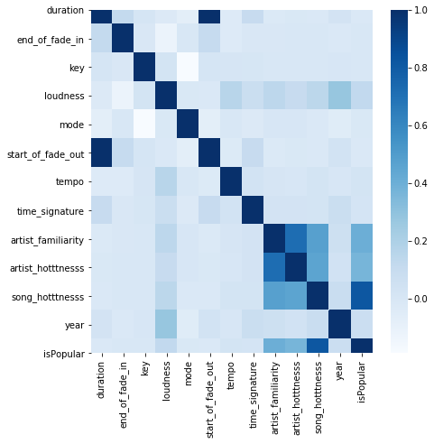
Data Exploration
After data cleansing, left with 306297 rows
Correlation matrix:
We can see a high correlation between
duration and start_of_fade_out
artist_familiarity and artist_hotness
song_hotness with artist_familiarity and artist_hotness

Slide 7
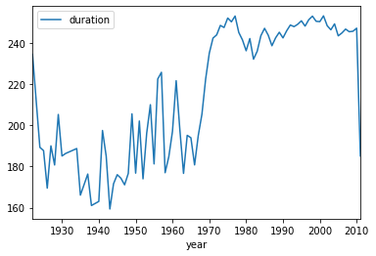
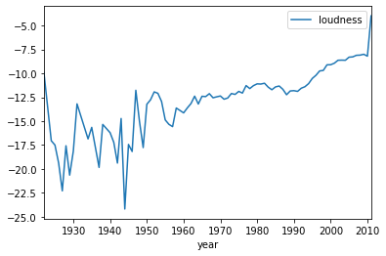
Data Exploration
• Data Trends over the years

Slide 8
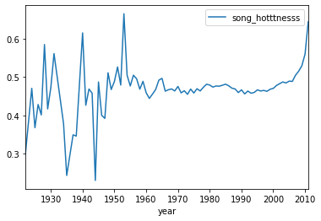
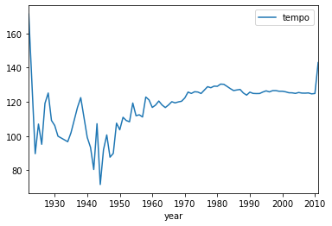
Data Exploration
• Data Trends over the years

Slide 9
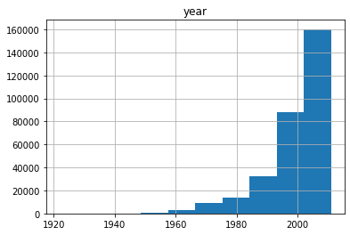
Data Exploration
• Number of Songs Over the years

Slide 10
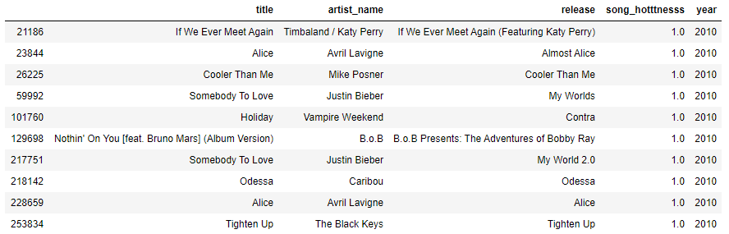
Data Exploration
Most Popular songs sorted by song popularity and year

Slide 11
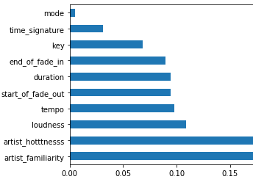
Feature Selection
Extra Trees Classifier to determine feature importance score
We have removed variables which are not significant to our analysis :
Mode, time_signature, key
By removing these variables we were able to achieve high performance because their p-value is high and does not contribute significantly to our model
We have verified these features using RFE (Recursive Feature Elimination)

Slide 12
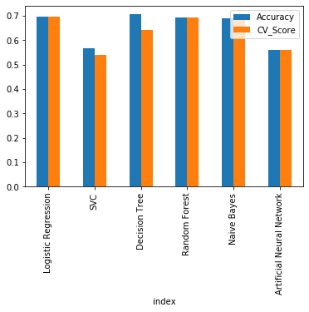
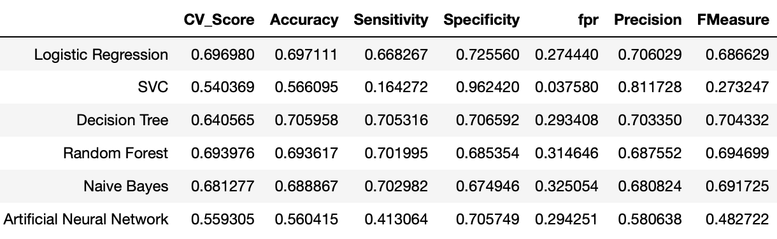
Model Selection

Slide 13
Model Evaluation
Logistic Regression gives the best accuracy of all the models tried
It also had the best Cross validation Score and Accuracy (0.69 and 0.69)
Parameters for model building
For Random forest: 100 decision trees
We tried altering the parameters like max_depth, n_estimators to maximize accuracy

Slide 14
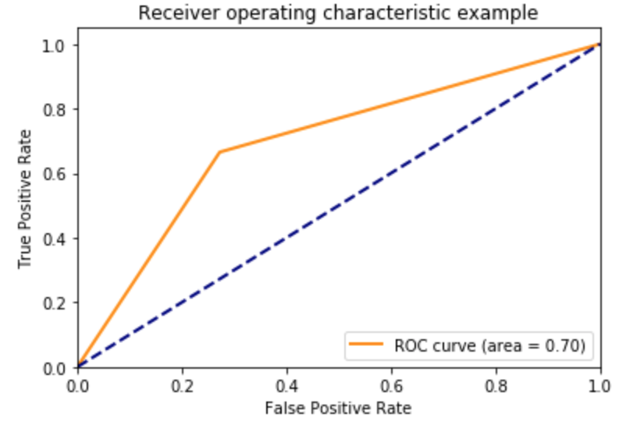
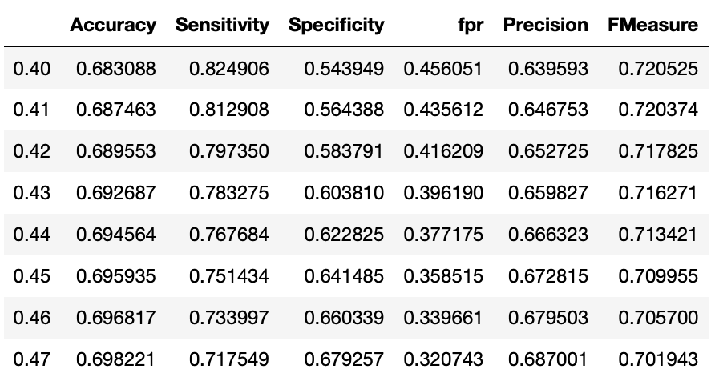
Model Evaluation
We have achieved an area under curve of 70%
We have also validated the model by checking the evaluation metrics for different thresholds

Slide 15
Conclusion and Limitations
Predicted song popularity based on song features
Artist familiarity, Artist Hotness, Loudness, Tempo, End of Fade In are top five features
Logistic Regression gave the best results
Limitations
Music is a complex item to analyze as it contains many layers of dependent and independent factors that can influence a user into making some random looking choices.
The approach presented here to solve the problem was limited by the computational resources available.
We removed variables based on statistical techniques but based on literacy survey we could have retained a few in order to get more optimal results.

Slide 16
Future Work
We can do sentiment analysis on the lyrics and include genres to build the model.
It would be interesting to see the use of some of the open source libraries, like Apache Mahout and Apache Hadoop, to facilitate the solving of bigger matrices than what is encountered here.
We can segment users based on their preferences and pick songs accordingly for them

Slide 17


Thank You

